Slide 1
Corona Travel
Requirements and analysis model

Slide 2
Product description
Our goal in to allow users to travel online from home via any device of their liking. They'll start by opening an app or a link and choosing a desired destination. After choosing a location, users can choose to view destination in 3D, look at some 3D photos or videos or learn some facts about the place.
Team: Sofya Donskaya, system analyst; Elena Karelina, backend developer; Danil Kireev, frontend developer; Artem Filimonov, backend developer + API integrator
Repo: https://github.com/randomunrandom/corona_travel
Report: https://docs.google.com/presentation/d/1L2dsEKCy_bkyYo2R88G_ctRGggT6wXFUKtpeL9LHwGw/edit?usp=sharing

Slide 3
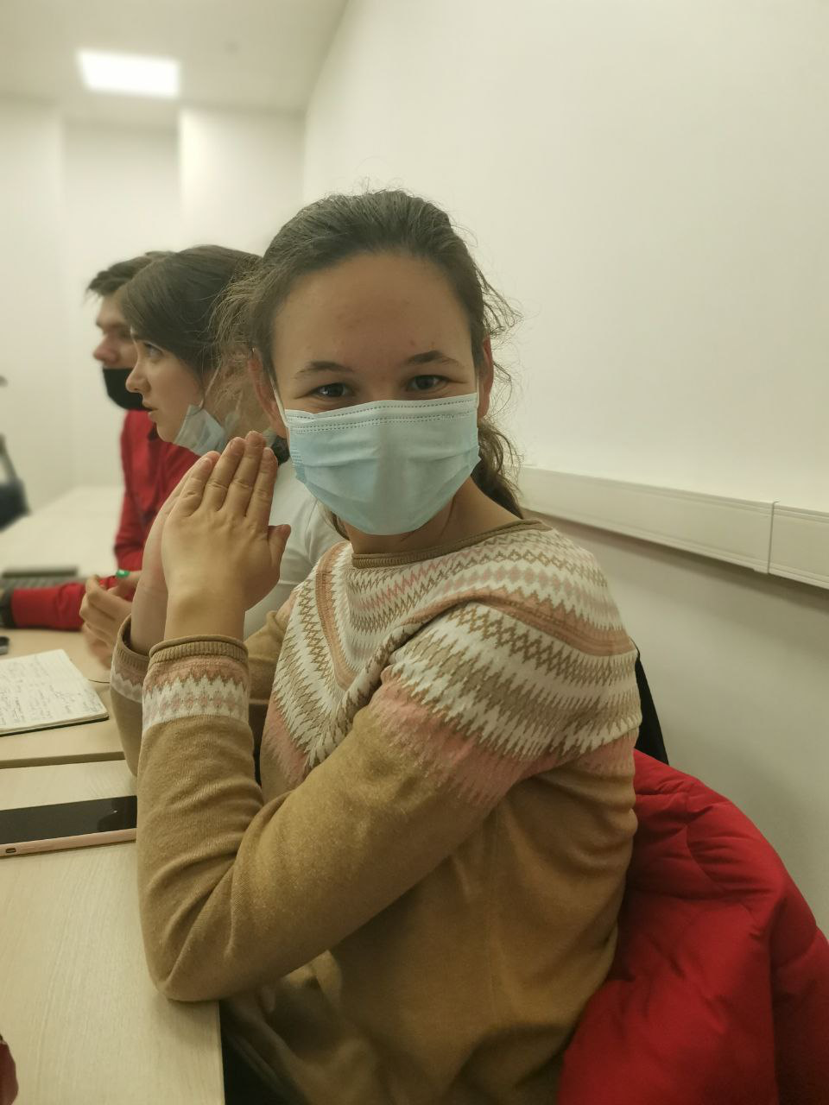

Personas
Name: Lena
21 y. o.
Software engineer student
and C++ developer
wants to go to a new country to meet new culture but can not do it because of the quarantine
Name: Sergey
38 y. o.
has 5 kids
does not have money to travel with family

Slide 4
Story Map
As a <Sergey>
I want to <travel abroad, observe nature and visit new places>
So that <I will gain a new experience and will not spend much time and money>
I want to <choose the destination and go to explore new sights>
So that <I will be surrounded by nice landscapes>
I want to <listen to nice sounds and enjoy waterfalls>
So that <I can relax after work>
As a result I have relaxed and start loving my children again :Ↄ
As a <Lena>
I want to <relax after my work and studying>
So that <I will be recharged for the next day>
I want to <move to another country and get known with historical facts and have a fun time by solving quiz>
So that <I will gain knowledge and experience>
As a result I have done it and enjoyed my life :)

Slide 5
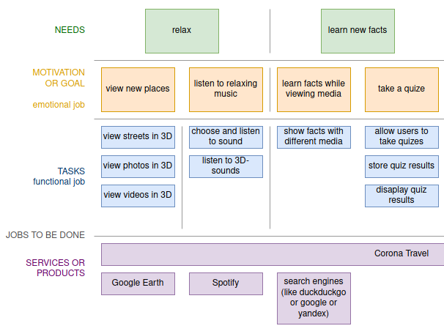
Story map

Slide 6
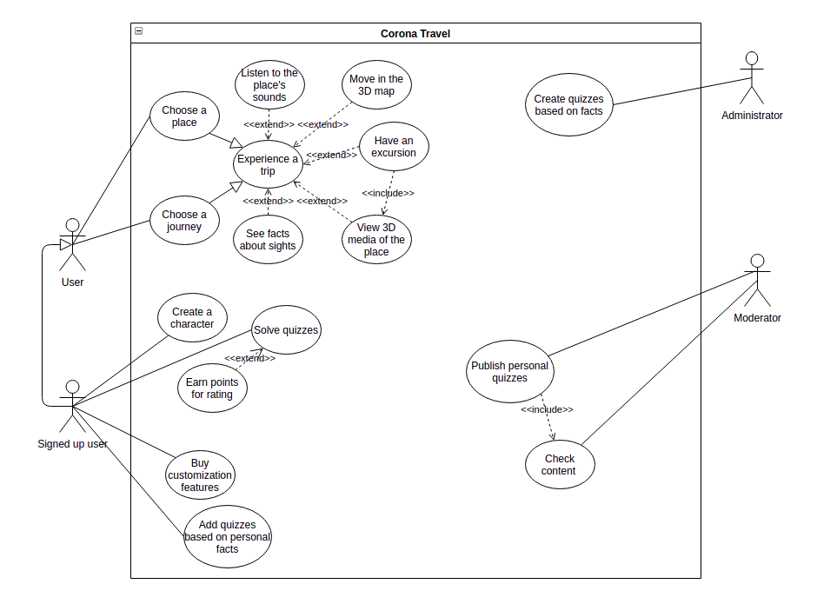
Use case diagram
Scenarios: https://github.com/randomunrandom/corona_travel/wiki/Scenarios

Slide 7
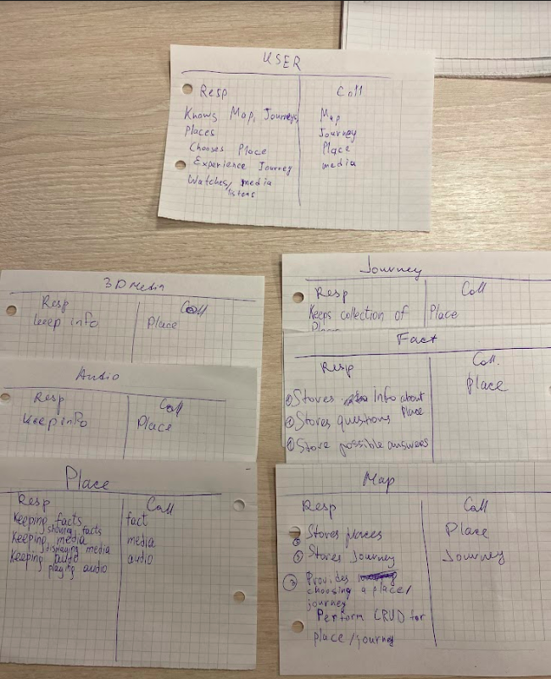
Interaction analysis

Slide 8
Interaction analysis
Use case | Cooperation name | Used roles | Candidate classes
Choose Journey | Choose and view Journey | User - actor, Journey - provider | User, Journey
Choose Journey | View Place | User - actor, Place - provider | User, Place
Move on 3D Map | Moving on Place | User - actor, Map - media provider, Place - storage | User, Place, Map
Read facts | Showing facts | User - actor, Fact - information, Place - storage | User, Place, Fact
Listen to the sounds | Playing sounds | User - actor, Audio - info, Place - storage | User, Place, Audio
Have a quiz | Solving quiz | User - actor, Fact - information, Quiz - storing links between | User, Fact, Quiz
View quiz results | View results | User - actor, System - storage and provider | User, System

Slide 9
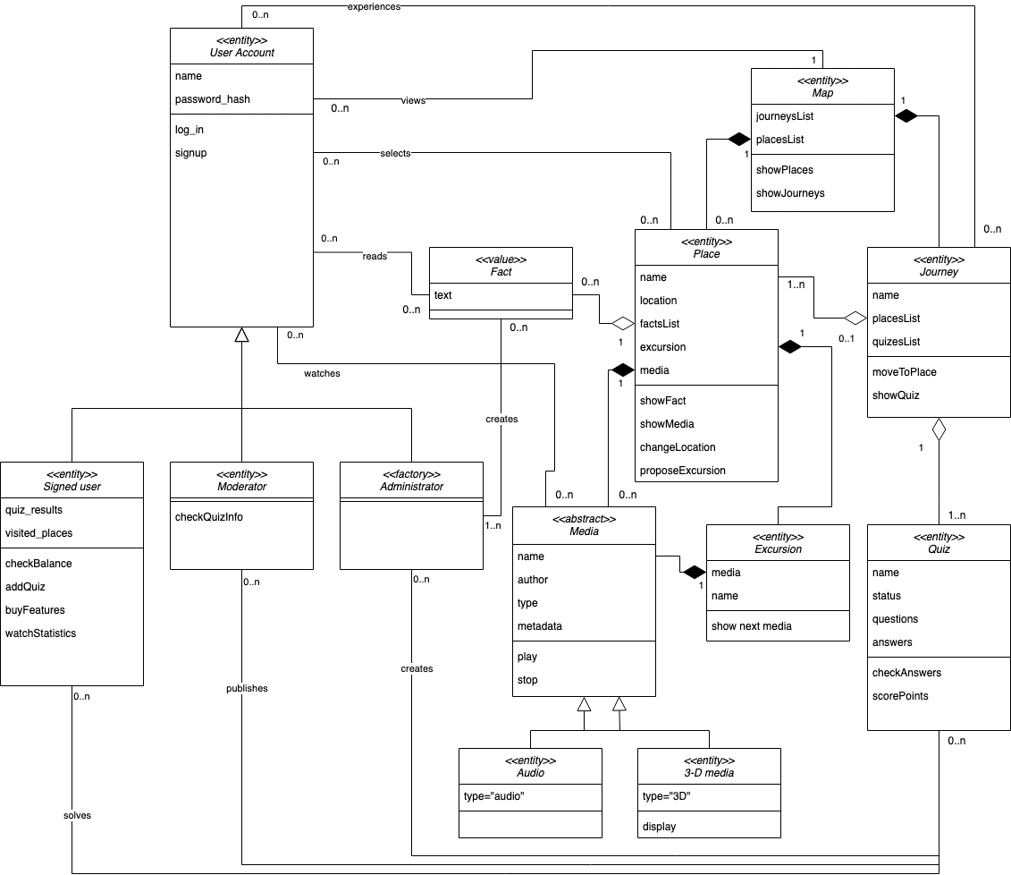
Final class diagram

Slide 10
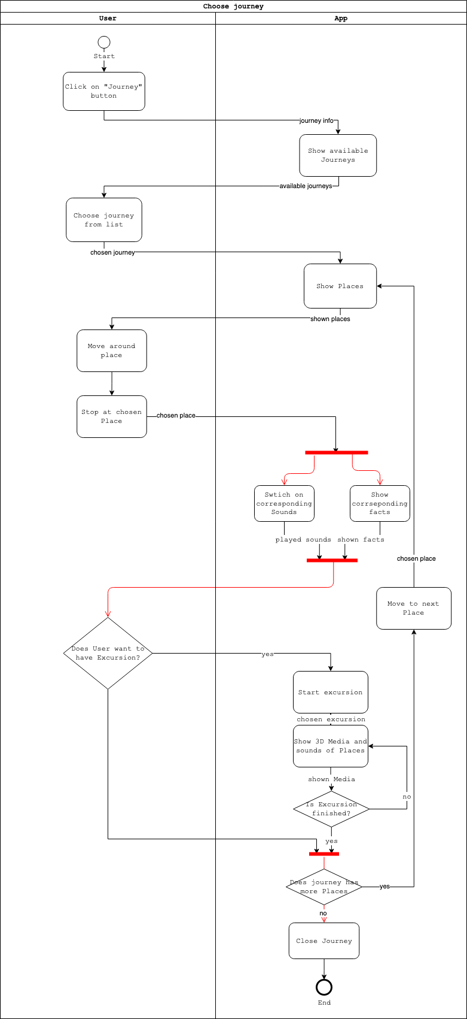
Detailed behavior

Slide 11
Detailed behavior

Slide 12
Detailed behavior

Slide 13
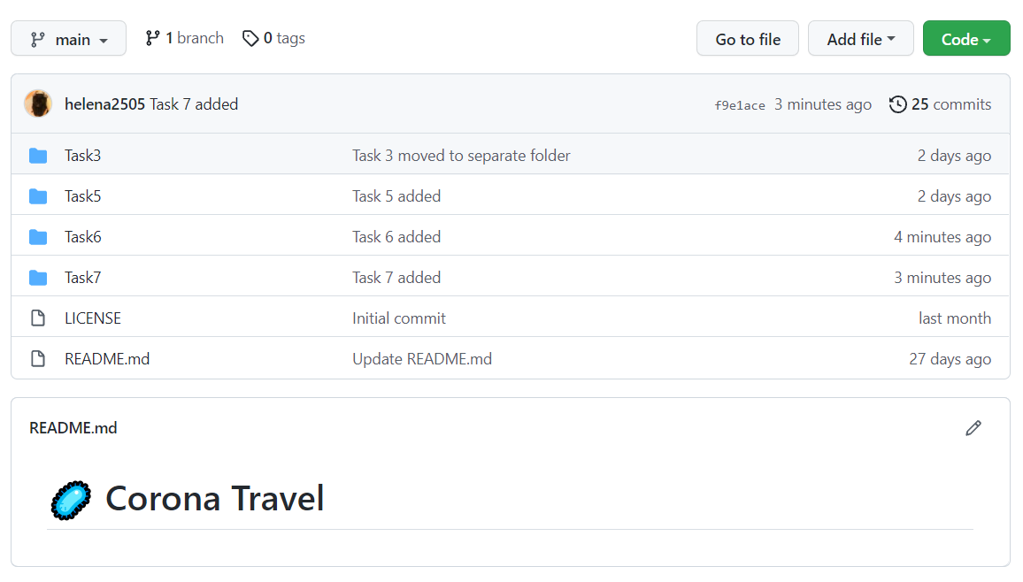
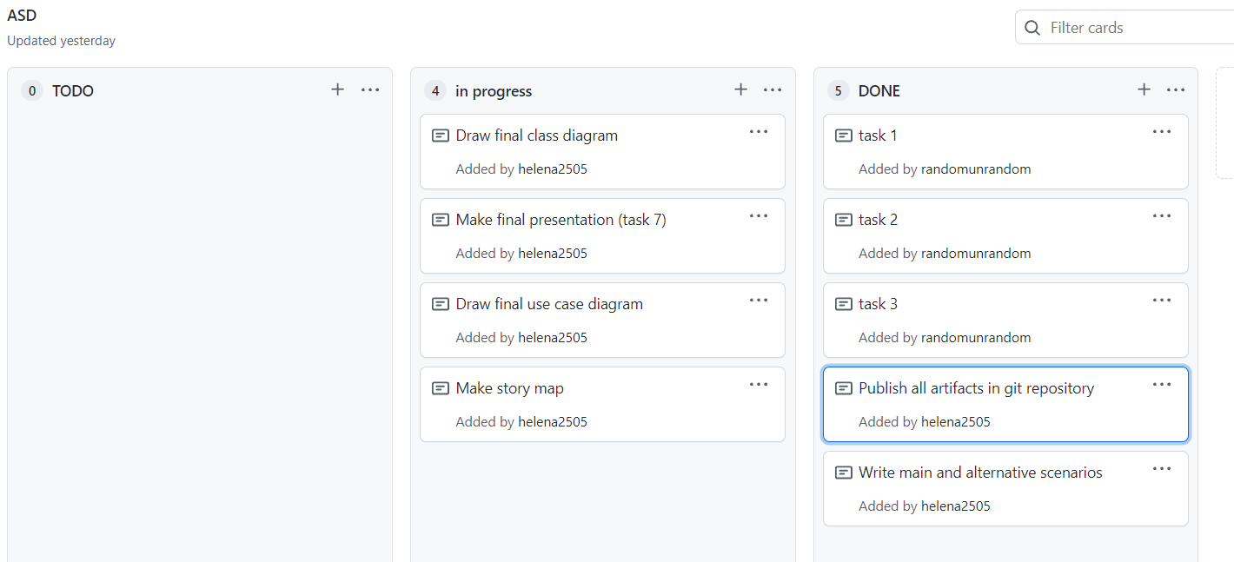
Repository structure

Slide 14
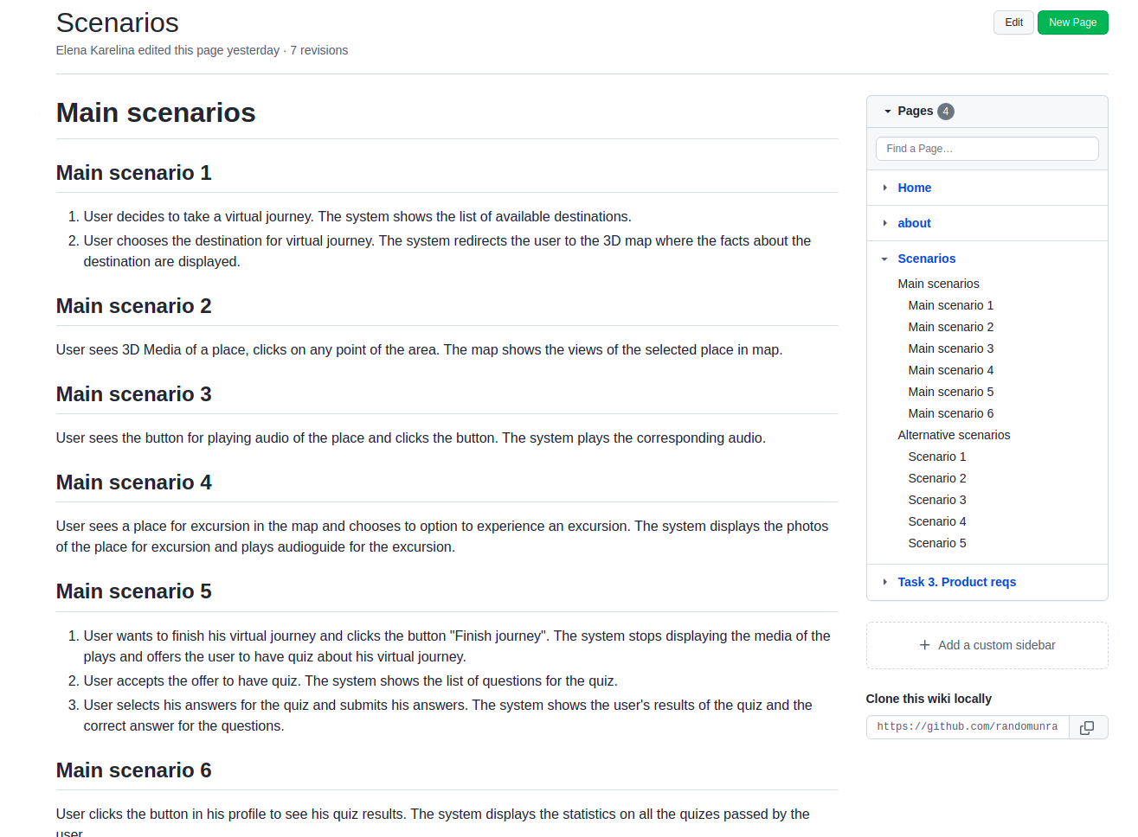
Repository structure

Slide 15



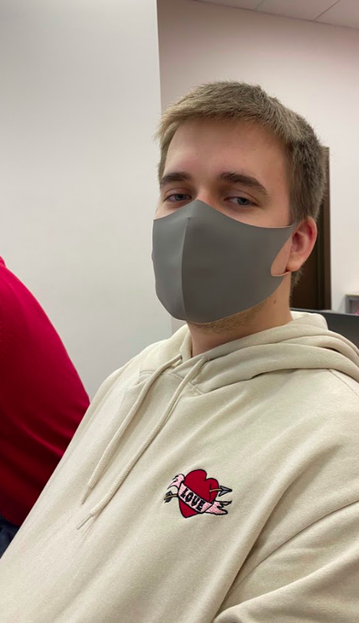
Team and roles
Elena Karelina, @e_karelina,
Interaction analysis + jobs
Sofya Donskaya, @do_nsk,
Use cases
Artem Filimonov, @pe4enko322,
Activity diagram
Danil Kireev, @unrndm,
Class diagram, Story map

